Slide 1
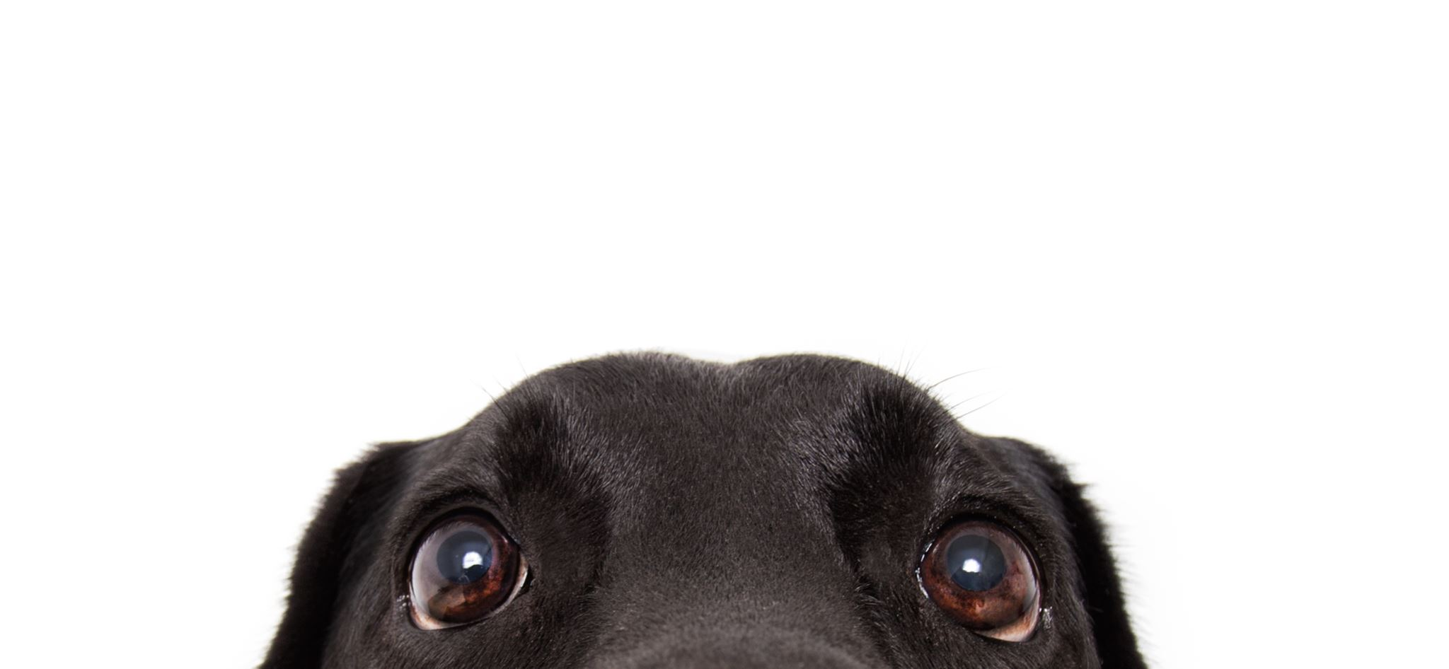
GDPR/LGPD

Slide 2
What is personal data?

Slide 3
What is personal data?
Personal data is any data (i.e. any recorded information) about a person that you can identify, either directly or indirectly (https://gdpr-info.eu/art-4-gdpr/)
Notes:
Discussion moment then definition.

Slide 4


Definição: Dados Pessoais
LGPD: dado pessoal: informação relacionada a pessoa natural identificada ou identificável (O que é a LGPD — Governo Digital)
GDPR: ‘personal data’ means any information relating to an identified or identifiable natural person (‘data subject’); an identifiable natural person is one who can be identified, directly or indirectly (Art. 4 GDPR – Definitions - General Data Protection Regulation (GDPR))

Slide 5
Personal data
Name
Profession
Number of patients
Instagram followers
Diagnosis
Social Security number
Random ID
Geolocation

Slide 6

Notes:
Ground rules

Slide 7
Guess who!
ID | Age | Profession | Gender | Instagram followers (millions)
HHF73KK02051985M | 40 | Athlete | Not disclosed | 600-700
JKF34KK05021972M | 53 | Actor | Male | 200-600
IIL37IK09171950M | NA | Politician | Not disclosed | 90+
Certain data points can become identifying when they are unique or rare, specially when combined with other data sources. Think of rare diseases, specific job titles like “CEO of a Fortune 500 company”, unusual combinations of hobbies and locations, or publication records in niche academic fields.
What about AI?
Notes:
Exercise. Key message: some data might be personal pending their uniqueness/universe. Attention is important. Some data might not be as anonymous as you think (see ID and link it to the idea that any ID number is by definition an identifier if a key exists: more on this in the next slide).
AI warning: ask who used AI to find the answer. How fast it can merge and combine data sources.

Slide 8
Exercício
ID | Sexo | Idade | Profissão | Seguidores no Insta

Slide 9
Exercício
ID | Sexo | Idade | Profissão | Seguidores no Insta
19850205-88780 | ? | ? | ? | 694m

Slide 10
Exercício
ID | Sexo | Idade | Profissão | Seguidores no Insta
19850205-88780 | M | 40 | Jogador futebol | 694m

Slide 11
Exercício
ID | Sexo | Idade | Profissão | Seguidores no Insta
19850205-88780 | M | 40 | Jogador futebol | 694m
19920722-10247 | ? | ? | Artísta | > 400m

Slide 12
Exercício
ID | Sexo | Idade | Profissão | Seguidores no Insta
19850205-88780 | M | 40 | Jogador futebol | 694m
19920722-10247 | F | 33 | Artísta | > 400m

Slide 13
Exercício
ID | Sexo | Idade | Profissão | Seguidores no Insta
19850205-88780 | M | 40 | Jogador futebol | 694m
19920722-10247 | F | 33 | Artísta | > 400m
19500917-00875 | ? | ? | Politico(a) | > 90m

Slide 14
Exercício
ID | Sexo | Idade | Profissão | Seguidores no Insta
19850205-88780 | M | 40 | Jogador futebol | 694m
19920722-10247 | F | 33 | Artísta | > 400m
19500917-00875 | M | 74 | Politico(a) | > 90m

Slide 15
Exercício
ID | Sexo | Idade | Profissão | Seguidores no Insta
19850205-88780 | M | 40 | Jogador futebol | 694m
19920722-10247 | F | 33 | Artísta | > 400m
19500917-00875 | M | 74 | Politico(a) | > 90m
20011218-47885 | ? | ? | ? | > 120m

Slide 16
Exercício
ID | Sexo | Idade | Profissão | Seguidores no Insta
19850205-88780 | M | 40 | Jogador futebol | 694m
19920722-10247 | F | 33 | Artísta | > 400m
19500917-00875 | M | 74 | Politico(a) | > 90m
20011218-47885 | F | 23 | Cantora | > 120m

Slide 17
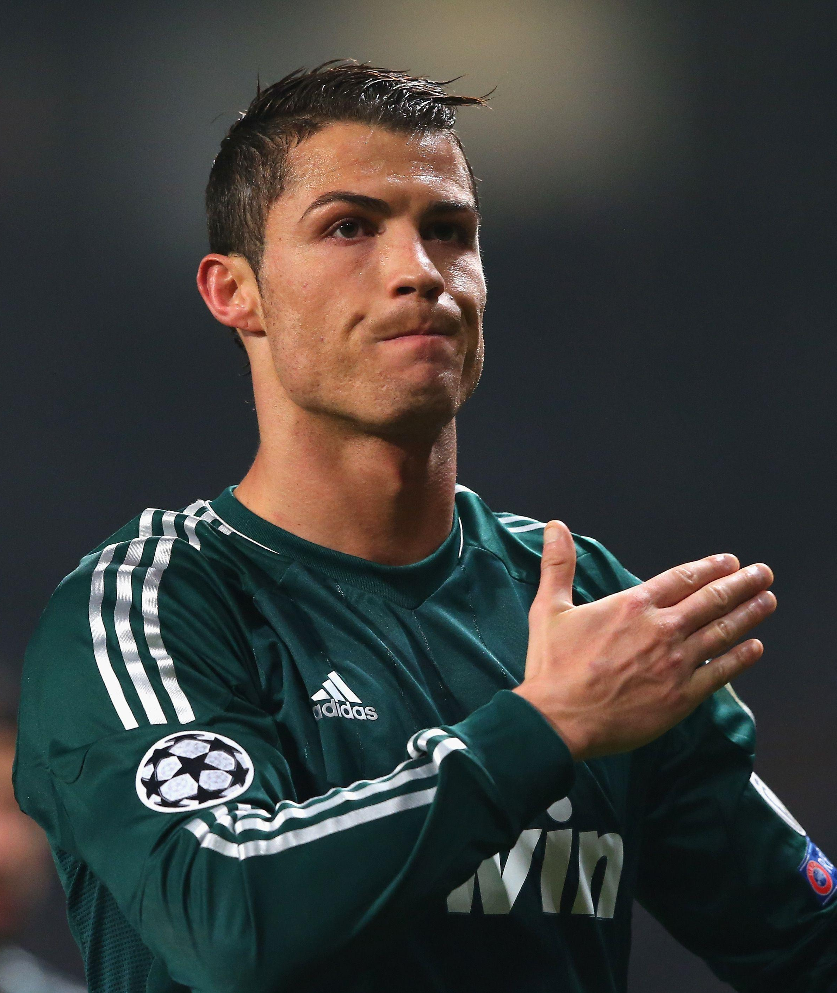
Personal data
Certain data points can become identifying when they are unique or rare, specially when combined with other data sources. Think of rare diseases, specific job titles like “CEO of a Fortune 500 company”, unusual combinations of hobbies and locations, or publication records in niche academic fields.
What about AI?

Slide 18
Notes:
Ground rules

Slide 19
Personal data
Name
Profession
Number of patients
Instagram followers
Diagnosis
Social Security number
Random ID
Geolocation

Slide 20
Personal data
Name
Profession
Number of patients
Instagram followers
Diagnosis
Social Security number
Random ID
Geolocation
Caso 1: João Pedro
Caso 2: Pedro de Alcântara João Carlos Leopoldo Salvador Bibiano Francisco Xavier de Paula Leocádio Miguel Gabriel Rafael Gonzaga

Slide 21
Personal data
Name
Profession
Number of patients
Instagram followers
Diagnosis
Social Security number
Random ID
Geolocation
Caso 1: Barista nos USA
Caso 2: Rei na Inglaterra

Slide 22
Personal data
Name
Profession
Number of patients
Instagram followers
Diagnosis
Social Security number
Random ID
Geolocation
Specialidade | Anos de experiência | Número de pacientes por mês | Região
Uro | 25 | 80 | Tijuana

Slide 23
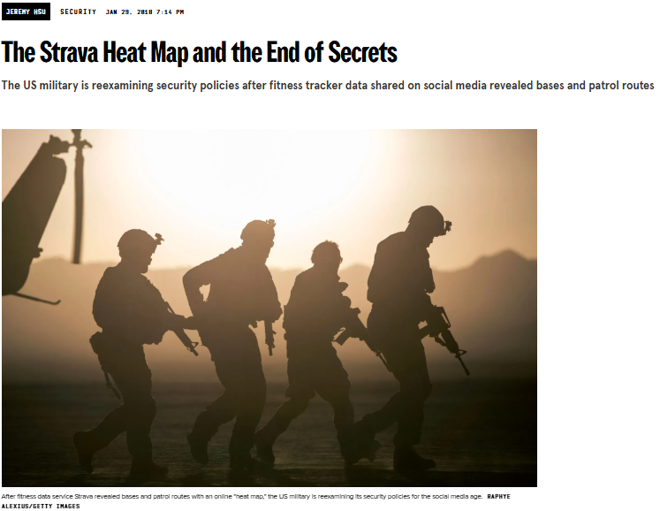
Geolocalização
Strava Data Heat Maps Expose Military Base Locations Around the World | WIRED

Slide 24
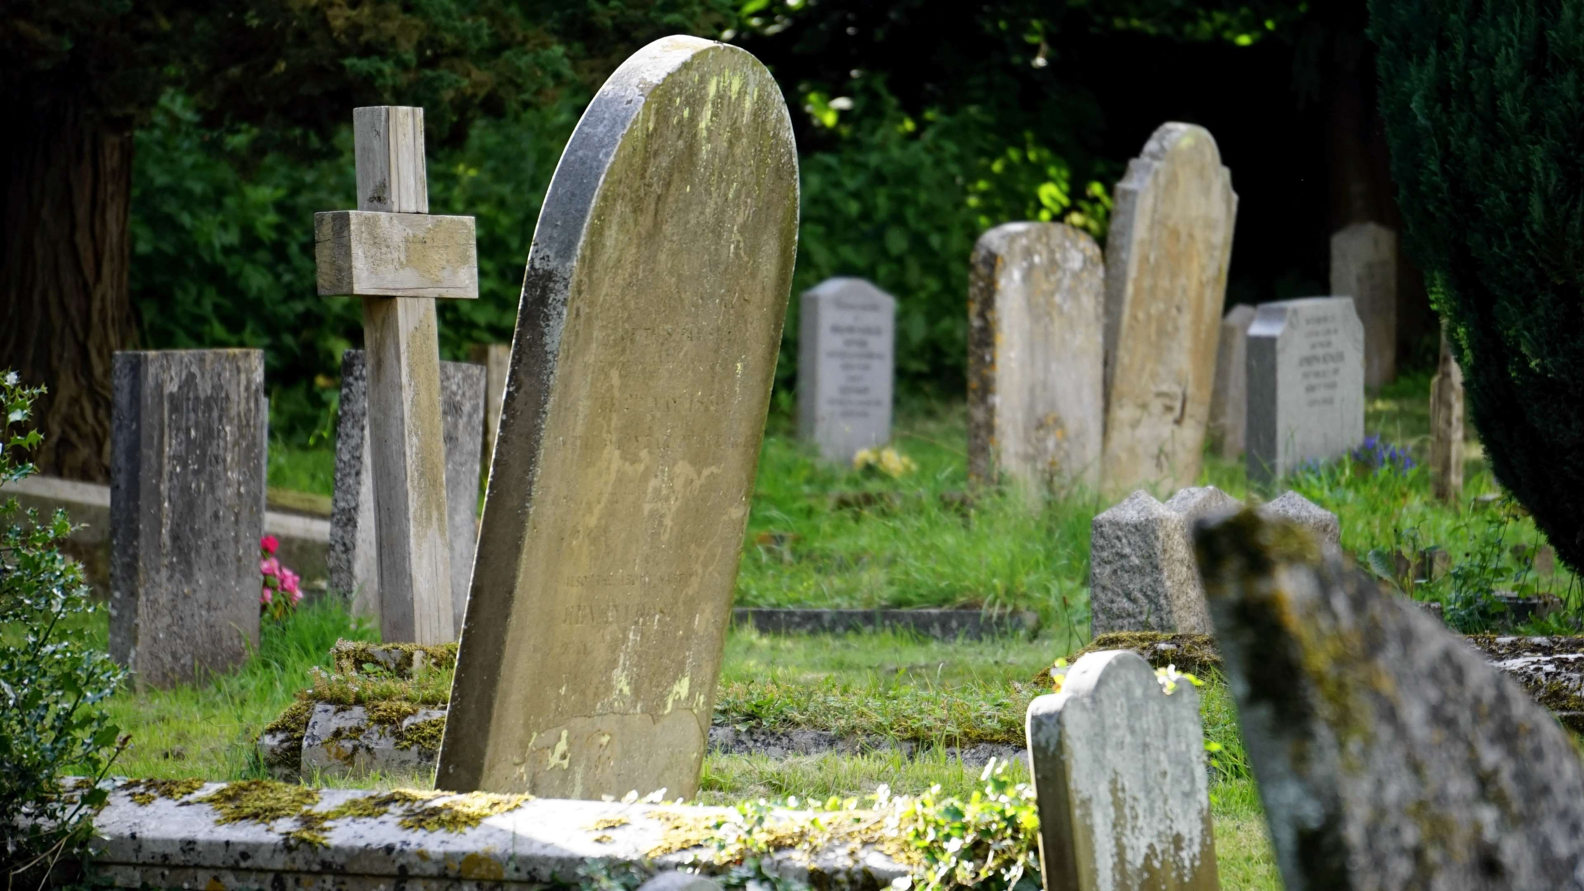
And what about the dead?

Slide 25
Deceased data
LGPD: é dado pessoal
GDPR: Não é dado pessoal

Slide 26
For what research purposes?
Marketing
Sensus
Scientific
Public
Private
If there is personal data, then GDPR is triggered.

Slide 27
How to share personal data
Email?
Wetransfer?
USB stick or external drive?
Letter?
RedCap!

Slide 28
Special category data
Within personal data exists special categories of data. These types of personal data can expose individuals to significant risks, such as discrimination, identity theft, privacy invasion, and social or economic harm. The special categories of personal data refer to:
Racial or ethnic origin
Political opinions
Religious/philosophical beliefs
Trade union membership
Genetic data
Biometric data
Health data
Sex life or sexual orientation
Notes:
What is specially important for us at VIB/UGent in life sciences? (Genetic/health data).

Slide 29
So what is sensitive data?
Notes:
Discussion moment. Sesntive data is not defined in the GDPR and widely used to fere to personal and/or special category data (and more, such as financial data, cvs, etc). Be sure to clarify with who you are talking to.

Slide 30
GDPR vs LGPD
Special Categories of Data (GDPR) are the same as Sensitive Data (LGPD)

Slide 31

Exercício
Sexo | Masculino
Idade | 42
Hora | 12:00:00 (UCT -3)
Data | 14/05/2025
Latitude | -23.5512
Longitude | -46.6343

Slide 32
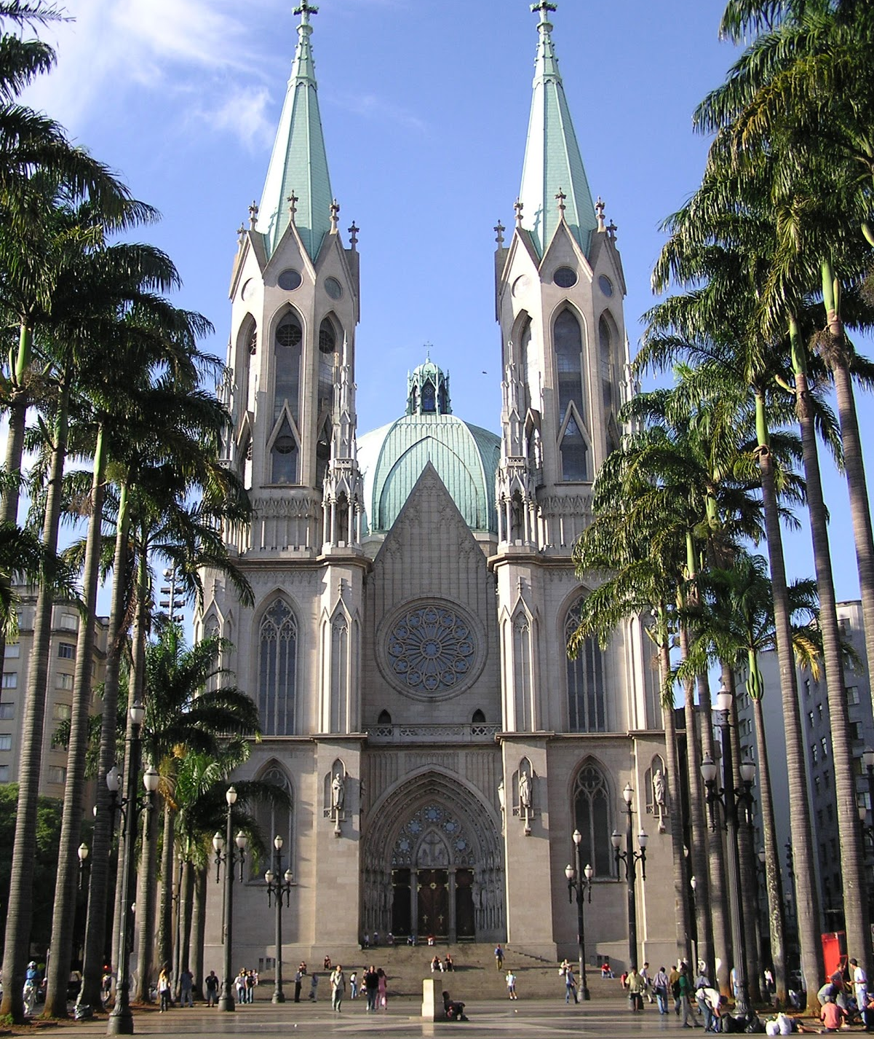
Exercício
Sexo | Masculino
Idade | 42
Hora | 12:00:00 (UCT -3)
Data | 14/05/2025
Latitude | -23.5512
Longitude | -46.6343

Slide 33
The GDPR - General Data Protection Regulation
As technology advanced, more and more personal and special category data was being collected, shared, and stored, often without clear rules or protections.
To ensure that EU data is protected, even when it’s processed outside the EU.
It gives people more control over their data and sets clear responsibilities for organizations that use it.
Notes:
As we’ve seen so far, data is any recorded information. Some data can be used to identify a person (personal data), and some types of data, like health or genetic information, can even be used to harm or discriminate against someone (special category data).

Slide 34
GDPR – 7 principles
Lawfulness, Fairness, and Transparency
Purpose Limitation
Data Minimization
Accuracy
Storage Limitation
Integrity and Confidentiality (Security)
Accountability
LGPD – 10 principles
Purpose
Adequacy
Necessity
Free Access
Data Quality
Transparency
Security
Prevention
Non-Discrimination
Accountability

Slide 35
GDPR principles
Lawfulness, Fairness, and Transparency: Data must be processed legally, fairly, and in a way that is transparent to the data subject.
Purpose Limitation: Data must be collected for specified, explicit, and legitimate purposes and not further processed in a manner incompatible with those purposes.
Data Minimization: Only data that is adequate, relevant, and limited to what is necessary should be collected.

Slide 36
GDPR principles
Accuracy: Personal data must be accurate and kept up to date. Inaccurate data should be corrected or deleted.
Storage Limitation: Data should be kept only for as long as necessary for the purposes for which it was collected.
Integrity and Confidentiality (Security): Data must be processed securely to protect against unauthorized access, loss, or damage.
Accountability: The data controller is responsible for compliance and must be able to demonstrate it

Slide 37
LGPD principles
Purpose: Processing must be for legitimate, specific, and explicit purposes informed to the data subject.
Adequacy: Data must be compatible with the purposes informed to the data subject.
Necessity: Processing should be limited to the minimum necessary for the intended purpose.
Free Access: Data subjects must have easy and free access to information about their data processing.

Slide 38
LGPD principles
Data Quality: Data must be accurate, clear, relevant, and up to date.
Transparency: Processing must be clear and accessible to data subjects.
Security: Technical and administrative measures must be used to protect data from unauthorized access and breaches.
PreventionMeasures: should be taken to prevent harm from data processing.
Non-Discrimination: Data must not be processed for unlawful or abusive discriminatory purposes.
Accountability: Controllers must demonstrate compliance and adopt effective measures.

Slide 39
Data Subject Rights
Right | Notes for Researchers
Right to be informed | Often fulfilled via informed consent forms or public notices
Right of access | May be restricted in research under GDPR Art. 89(2) with safeguards [rug.nl]
Right to rectification | Researchers must allow corrections unless it compromises scientific integrity
Right to erasure ("right to be forgotten") | GDPR allows derogation for research (Art. 89), LGPD requires anonymization when possible
Right to restrict processing | GDPR allows restriction exemptions for research with safeguards
Right to data portability | Less relevant in academic research, but important in clinical studies
Right to object | GDPR allows exemptions for research under Art. 89(2)
Right not to be subject to automated decision-making | Rare in research, but relevant in AI-driven health studies

Slide 40
Processing personal data for scientific research purposes
Processing special category data is prohibited. Unless:
The data subject has given consent
Necessary for the performance of a contract
Legal obligation of the data controller
Protection of vital interest of the data subject or another person
Necessary for a task of public interest
Necessary for purposes of the legitimate interest of the controller or a third party
Notes:
What is specially important for us at VIB/UGent in life sciences? (Genetic/health data).

Slide 41
The DPO
The Data Protection Officer (DPO) is a role within organizations that help interpret and apply the GDPR into companies and institutes. They are the experts and go to person for any questions, breaches, etc.
Contact: dpo@vib.be

Slide 42
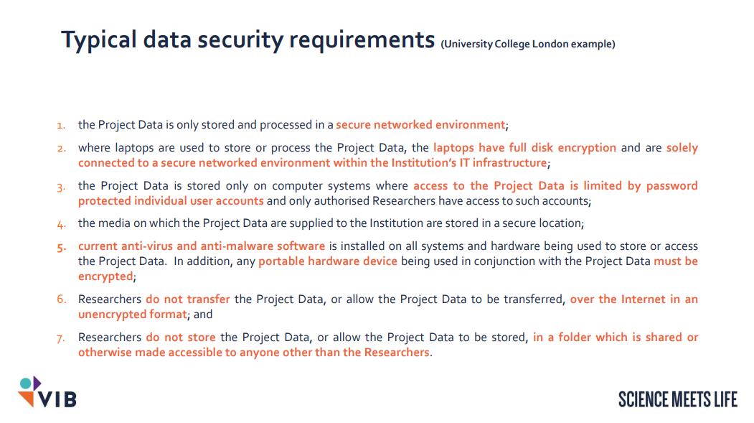

Slide 43
Pseudonymized and Anonymized data
Pseudonymized personal data that has been altered so that it cannot be linked to a specific person without additional information (i.e. key).
Only when personal data had been irreversibly changed or removed in a manner that no one can identify the person it belongs to, the data can be considered anonymized.
Notes:
Pseudonymized data is still considered personal data under the GDPR.
Here are a few practical examples on data anonymization:
Removing names, ID numbers, and contact details.
Removing or generalizing dates (e.g. replace exact birthdate with age range).
Removing location data or replacing it with broad regions (e.g. Flanders instead of Gent).
Small groups are merged to avoid singling out individuals.
Truly anonymized data is not considered personal data and therefore, is not subject to the GDPR.
Link to following slide: Special category data must be pseudonymized before being used.

Slide 44
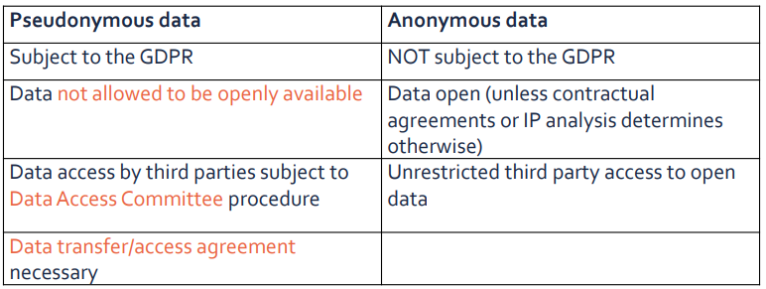
Differences

Slide 45
Considerations
To determine whether a natural person is identifiable, account should be taken of all the means reasonably likely to be used, such as singling out, either by the controller or by another person to identify the natural person directly or indirectly. To ascertain whether means are reasonably likely to be used to identify the natural person, account should be taken of all objective factors, such as the costs of and the amount of time required for identification, taking into consideration the available technology at the time of the processing and technological developments

Slide 46
Methods of anonymization
Methods of anonymization:
Removal of information that would allow to identify a person
Randomization
Aggregation
Anonymization must be irreversible

Slide 47
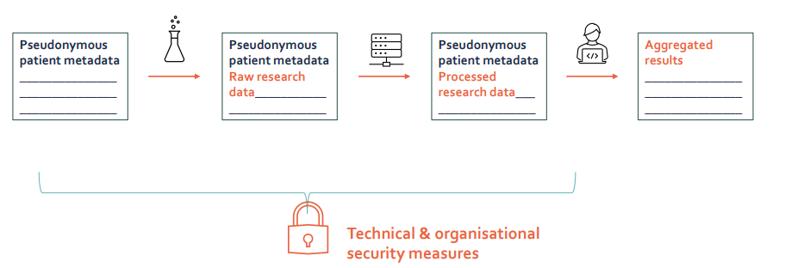
Data processing in research

Slide 48
Dados pessoais: de identificável à anônimo
Diretamente identificável | Indiretamente identificável | PSEUDO-ANÔNIMO | Dados de-identificados | Dados anônimos | Dados anônimos agregados
PESSOAL
ANÔNIMO
- Nome - Endereço - Número de Tel. - CPF | - Endereço de IP - Cookie | ID Criado aleatoriamente para substituir dados identificáveis (chave existente e separada) | Dados alterados (i.e. margens e intervalos) | Identificadores eliminados ou alterados. | e.g. Census

Slide 49
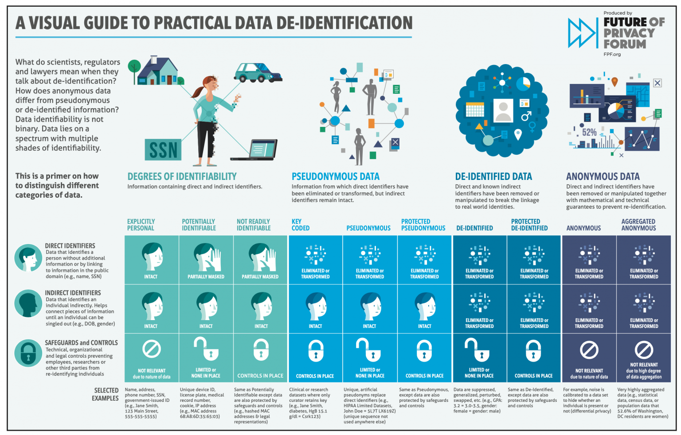
Guia Visual Anonimização de Dados

Slide 50
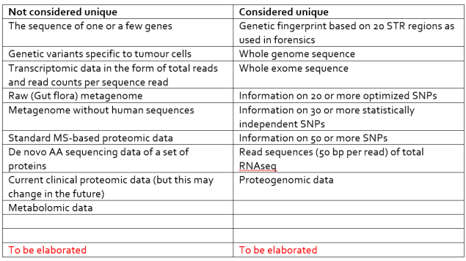
Examples

Slide 51
Identificável, anônimo ou pseudo-anônimo?
Código do Paciente | Idade | Diagnóstico | Marcador Genético | Código do Hospital
P001 | 45 | Diabetes | BRCA1+ | HOSP-23
P002 | 52 | Hipertensão | BRCA2- | HOSP-23
Faixa Etária | Região | Percentual com Hipertensão
18–30 | Sudeste | 12%
Nome | E-mail | Data da Consulta | Médico
João Pereira | joao.p@gmail.com | 10/05/2025 | Dr. Lima
Ana Souza | ana.souza@clinica.br | 12/05/2025 | Dr. Lima
Faixa Etária | Região | Diagnóstico | Gênero
50–59 | Serra da Saudade | Câncer de mama | Masculino
30–39 | São Paulo | Hipertensão | Feminino

Slide 52
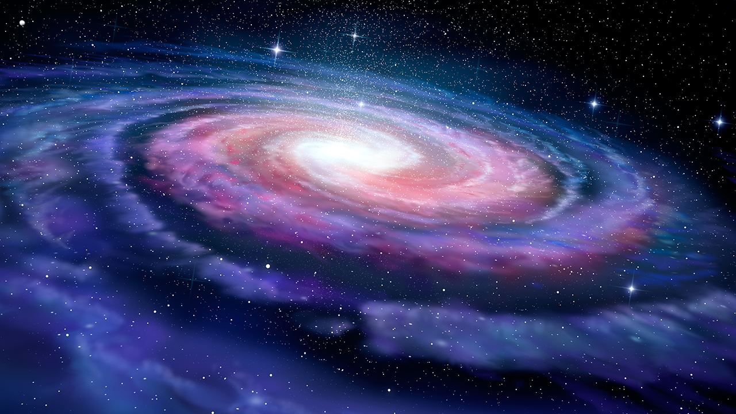
O UNIVERSO IMPORTA

Slide 53
Matheus Lourenço
Matheus.lourenco@vib.be

